Slide 1
Language Based Protection
To the degree that protection is provided in computer systems, it is usually achieved through an operating-system kernel, which acts as a security agent to inspect and validate each attempt to access a protected resource.
Since comprehensive access validation may be a source of considerable overhead, either we must give it hardware support to reduce the cost of each validation, or we must allow the system designer to compromise the goals of protection.
Satisfying all these goals is difficult if the flexibility to implement protection policies is restricted by the support mechanisms provided or if protection environments are made larger than necessary to secure greater operational efficiency

Slide 2
Policies for resource use may also vary, depending on the application, and they may be subject to change over time.
For these reasons, protection can no longer be considered a matter of concern only to the designer of an operating system.
It should also be available as a tool for use by the application designer, so that resources of an application subsystem can be guarded against tampering or the influence of an error.

Slide 3
Compiler-Based Enforcement
At this point, programming languages enter the picture.
Specifying the desired control of access to a shared resource in a system is making a declarative statement about the resource.
This kind of statement can be integrated into a language by an extension of its typing facility.
When protection is declared along with data typing, the designer of each subsystem can specify its requirements for protection, as well as its need for use of other resources in a system.
Such a specification should be given directly as a program is composed, and in the language in which the program itself is stated.
This approach has several significant advantages:

Slide 4
Protection needs are simply declared, rather than programmed as a sequence of calls on procedures of an operating system.
Protection requirements can be stated independently of the facilities provided by a particular operating system.
The means for enforcement need not be provided by the designer of a subsystem.
A declarative notation is natural because access privileges are closely related to the linguistic concept of data type.

Slide 5
Run-Time-Based Enforcement—Protection in Java
Because Java was designed to run in a distributed environment, the Java virtual machine—or JVM—has many built-in protection mechanisms.
Java programs are composed of classes, each of which is a collection of data fields and functions (called methods) that operate on those fields.
The JVM loads a class in response to a request to create instances (or objects) of that class.
One of the most novel and useful features of Java is its support for dynamically loading untrusted classes over a network and for executing mutually distrusting classes within the same JVM.

Slide 6
Because of these capabilities, protection is a paramount concern.
Classes running in the same JVM may be from different sources and may not be equally trusted.
As a result, enforcing protection at the granularity of the JVM process is insufficient. Intuitively, whether a request to open a file should be allowed will generally depend on which class has requested the open. The operating system lacks this knowledge.
Thus, such protection decisions are handled within the JVM.
When the JVM loads a class, it assigns the class to a protection domain that gives the permissions of that class.
The protection domain to which the class is assigned depends on the URL from which the class was loaded and any digital signatures on the class file.

Slide 7
For example, classes loaded from a trusted server might be placed in a protection domain that allows them to access files in the user’s home directory, whereas classes loaded from an untrusted server might have no file access permissions at all.
It can be complicated for the JVM to determine what class is responsible for a request to access a protected resource.
Accesses are often performed indirectly, through system libraries or other classes. For example, consider a class that is not allowed to open network connections.
It could call a system library to request the load of the contents of a URL.
The JVM must decide whether or not to open a network connection for this request. But which class should be used to determine if the connection should be allowed, the application or the system library?

Slide 8
The philosophy adopted in Java is to require the library class to explicitly permit a network connection.
More generally, in order to access a protected resource, some method in the calling sequence that resulted in the request must explicitly assert the privilege to access the resource.
By doing so, this method takes responsibility for the request. Presumably, it will also perform whatever checks are necessary to ensure the safety of the request.
Of course, not every method is allowed to assert a privilege; a method can assert a privilege only if its class is in a protection domain that is itself allowed to exercise the privilege

Slide 9
This implementation approach is called stack inspection. Every thread in the JVM has an associated stack of its ongoing method invocations.
When a caller may not be trusted, a method executes an access request within a doPrivileged block to perform the access to a protected resource directly or indirectly.
doPrivileged() is a static method in the AccessController class that is passed a class with a run() method to invoke.
When the doPrivileged block is entered, the stack frame for this method is annotated to indicate this fact. Then, the contents of the block are executed. When an access to a protected resource is subsequently requested, either by this method or a method it calls, a call to checkPermissions() is used to invoke stack inspection to determine if the request should be allowed.

Slide 10
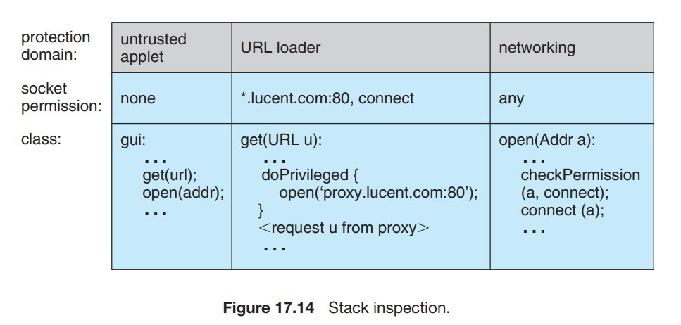

Slide 11
The inspection examines stack frames on the calling thread’s stack, starting from the most recently added frame and working toward the oldest.
If a stack frame is first found that has the doPrivileged() annotation, then checkPermissions() returns immediately and silently, allowing the access.
If a stack frame is first found for which access is disallowed based on the protection domain of the method’s class, then checkPermissions() throws an AccessControlException.
If the stack inspection exhausts the stack without finding either type of frame, then whether access is allowed depends on the implementation (some implementations of the JVM may allow access, while other implementations may not).

Slide 12
Stack inspection is illustrated in Figure 17.14. Here, the gui() method of a class in the untrusted applet protection domain performs two operations, first a get() and then an open().
The former is an invocation of the get() method of a class in the URL loader protection domain, which is permitted to open() sessions to sites in the lucent.com domain, in particular a proxy server proxy.lucent.com for retrieving URLs.
For this reason, the untrusted applet’s get() invocation will succeed: the checkPermissions() call in the networking library encounters the stack frame of the get() method, which performed its open() in a doPrivileged block.
However, the untrusted applet’s open() invocation will result in an exception, because the checkPermissions() call finds no doPrivileged annotation before encountering the stack frame of the gui() method.

Slide 13
More generally, Java’s load-time and run-time checks enforce type safety of Java classes.
Type safety ensures that classes cannot treat integers as pointers, write past the end of an array, or otherwise access memory in arbitrary ways.
Rather, a program can access an object only via the methods defined on that object by its class.
This is the foundation of Java protection, since it enables a class to effectively encapsulate and protect its data and methods from other classes loaded in the same JVM.
For example, a variable can be defined as private so that only the class that contains it can access it or protected so that it can be accessed only by the class that contains it, subclasses of that class, or classes in the same package.
Type safety ensures that these restrictions can be enforced.

